Slide 1


Real Time Violence and Hate speech Detection in Video for Kid
using Kafka and PySpark
Sinh viên thực hiện:
Đào Hoàng Dũng 21521972
Huỳnh Thị Kim Ngân 21520357
Hồ Thanh Tịnh 20520813
GVHD: TS. Đỗ Trọng Hợp

Slide 2

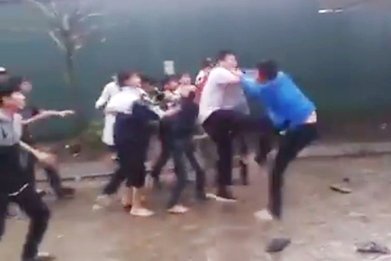
Introduction
Children are being exposed to social networks from a very early age. Negative, violent content such as bloody images and fights or hate speech will have a negative impact on children.
Age-based content filtering and age-negative content detection models are needed.
Besides, most social networks are free posting platforms, content does not need to be censored to appear. Using that as motivation, we want to develop Real Time Violence and Hate speech Detection in Video for Kid using Big Data.

Slide 3
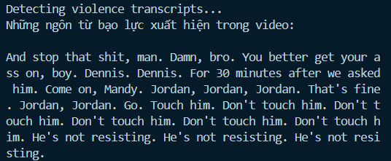
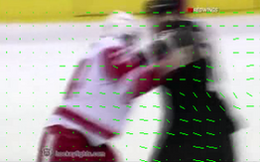

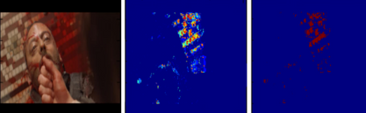



Introduction
Input
Video and audio media
Output
Label Violence or Non-Violence

Slide 4
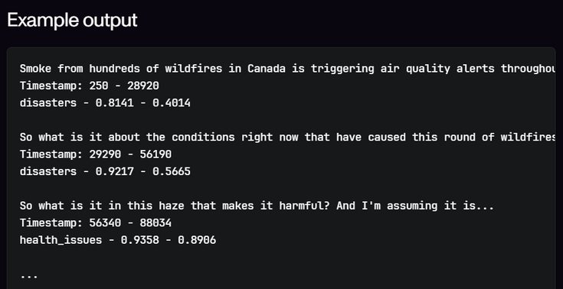
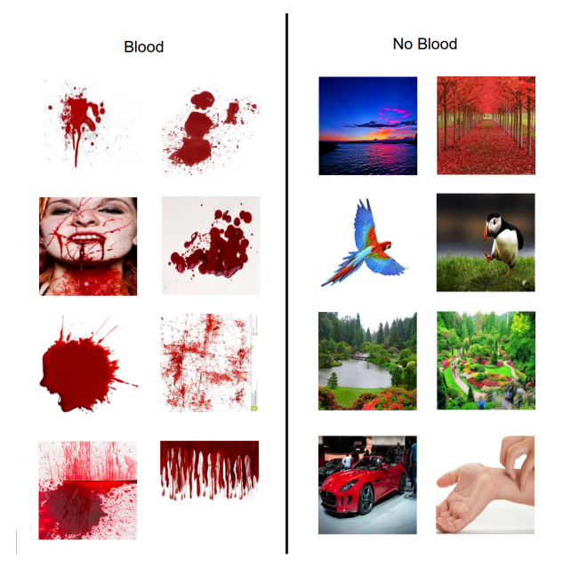

Sample audio’s output from the AssemblyAI - Audio feature
Feature Extraction
Sample frames from the fight videos in the Hockey
Blood-Feature using Blood Probability Map (BPM) to classify

Slide 5
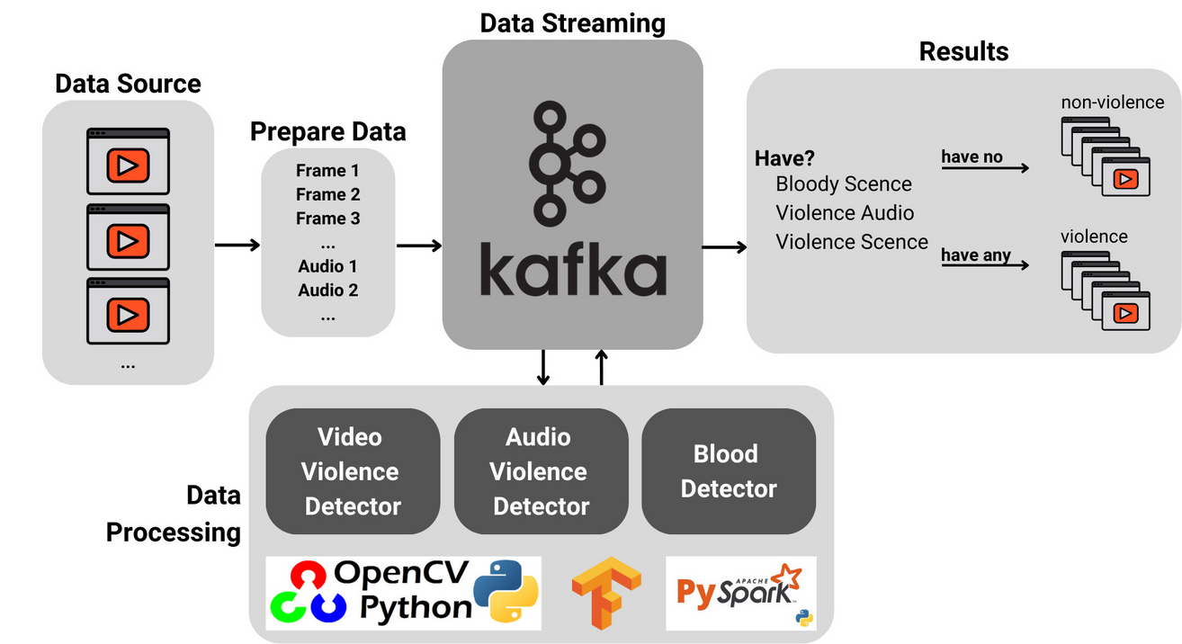
Methodology
Our system
Input: Video clips, which need to be detected whether they are safe for children or not.
Output: Label Violence or Non-Violence. We stipulate that if a video does not contain elements of fighting, violence, blood, or hate speech, it is considered safe for children and labeled Violence.

Slide 6
Experiments
Violence Detection On Frames
Dataset: Hockey Dataset, Movies Dataset, RLVS Dataset
Models: CNN-LSTM, ConvLSTM, Hybrid CNN-LSTM-Conv3D
Blood Detection On Frames
Dataset: Movies Dataset
Models: ResNet50, VGG16, InceptionV3, EfficienNetB0, MobileNetV2
Violence Detection On Audio
Dataset: RLVS Dataset

Slide 7
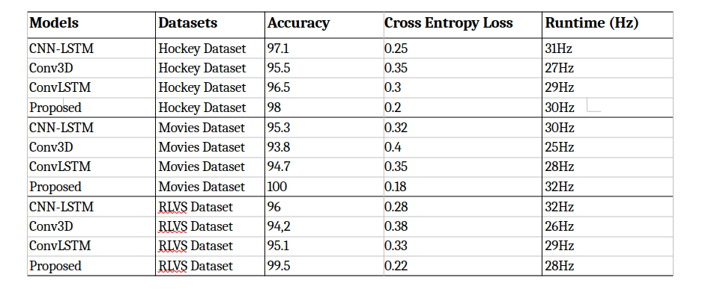
Experimental Results

Slide 8
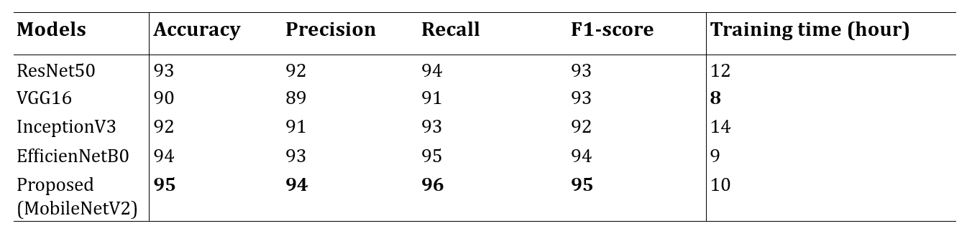
Experimental Results

Slide 9
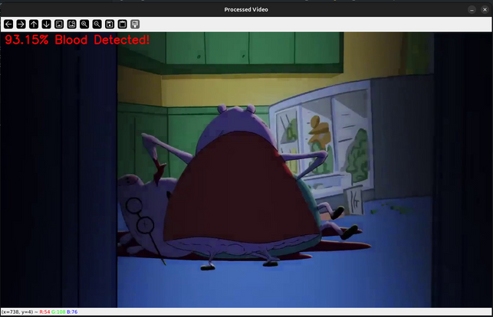
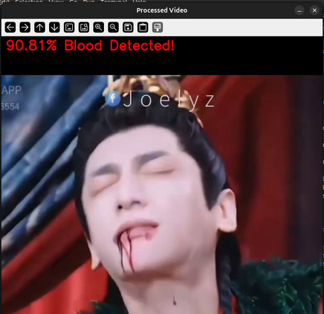


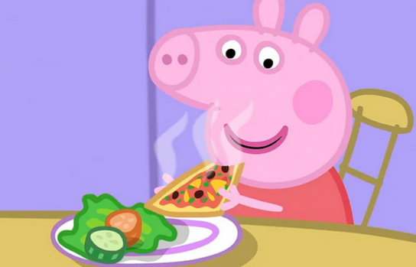
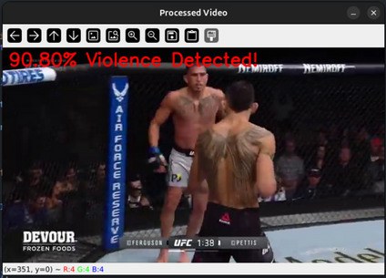
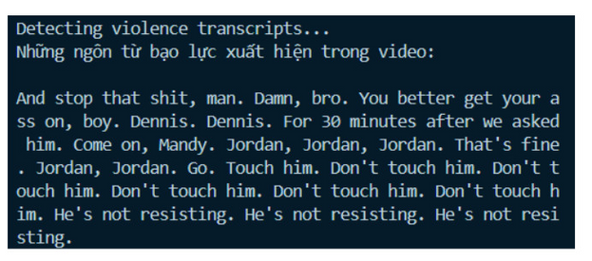
Results on Youtube videos
We collected an additional 50 video clips from YouTube and manually labeled them to evaluate the system when applied in real-world situations.
On final task (violence or not), our system reached 90% on accuracy and 85% on recall on 50 Youtube video we collected and annotated.
VIOLENCE
NON-VIOLENCE

Slide 10
Conclusion
We propose a system to detect violence through video and audio using Kafka and Pyspark.
We have successfully tested the combination of the best models and produced a model with full features for detecting violence, bloody video, and hate-speech word from video.

Slide 11
THANKS!
Do you have any question?

